Slide 1
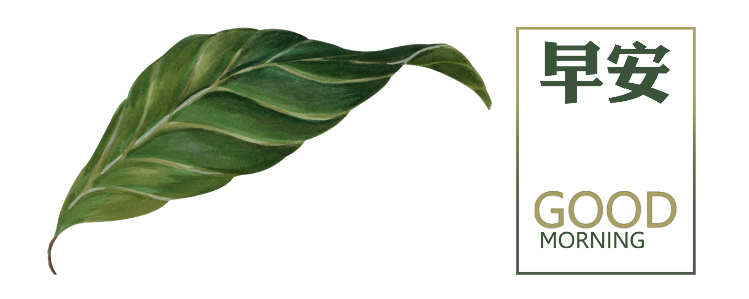
Plant Leaf Disease Classification

Slide 2
Team Members
M.V.N.Sai Harshith
(20MID0066)
Mitta Sai Nitish
(20MID0054)
Channaka Manideep
(20MID0172)
A Girish Kumar
(20MID0170)

Slide 3
CONTENTS
1
Introduction
2
Roadmap
3
Approach Proposal
4
Conclusion

Slide 4
01
Introduction and Problem Statement

Slide 5
Problem Statement
Plant diseases can cause significant damage to crops, leading to financial losses for farmers.
Solution: Develop a machine learning or Deep Learning model that can accurately classify plant diseases from images, allowing farmers to take preventive measures early on.
OBJECTIVES:
To identify the plant disease.
To classify the plant disease.
To predict the severity of the plant disease.
To track the spread of the plant disease.
To develop new treatments for plant diseases.

Slide 6
CONSTRAINTS:
Accuracy
Computational Resources
Generalization
Interpretability

Slide 7
02
Roadmap

Slide 8
Roadmap
Data collection
Data preprocessing
Model training
Model evaluation
Model deployment

Slide 9
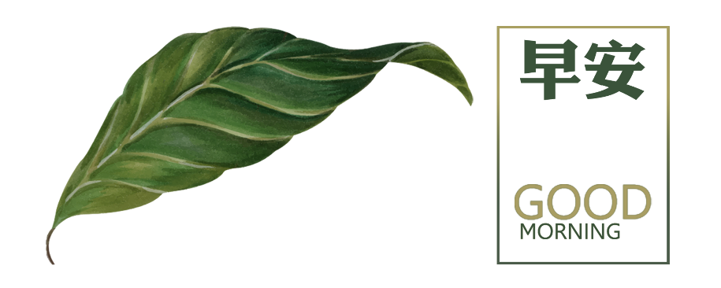
Alternative Approaches for the Project
Utilizing Pre-trained Models
Training a Model from Scratch
Transfer Learning
Ensemble Methods

Slide 10
03
Approach Proposal

Slide 11
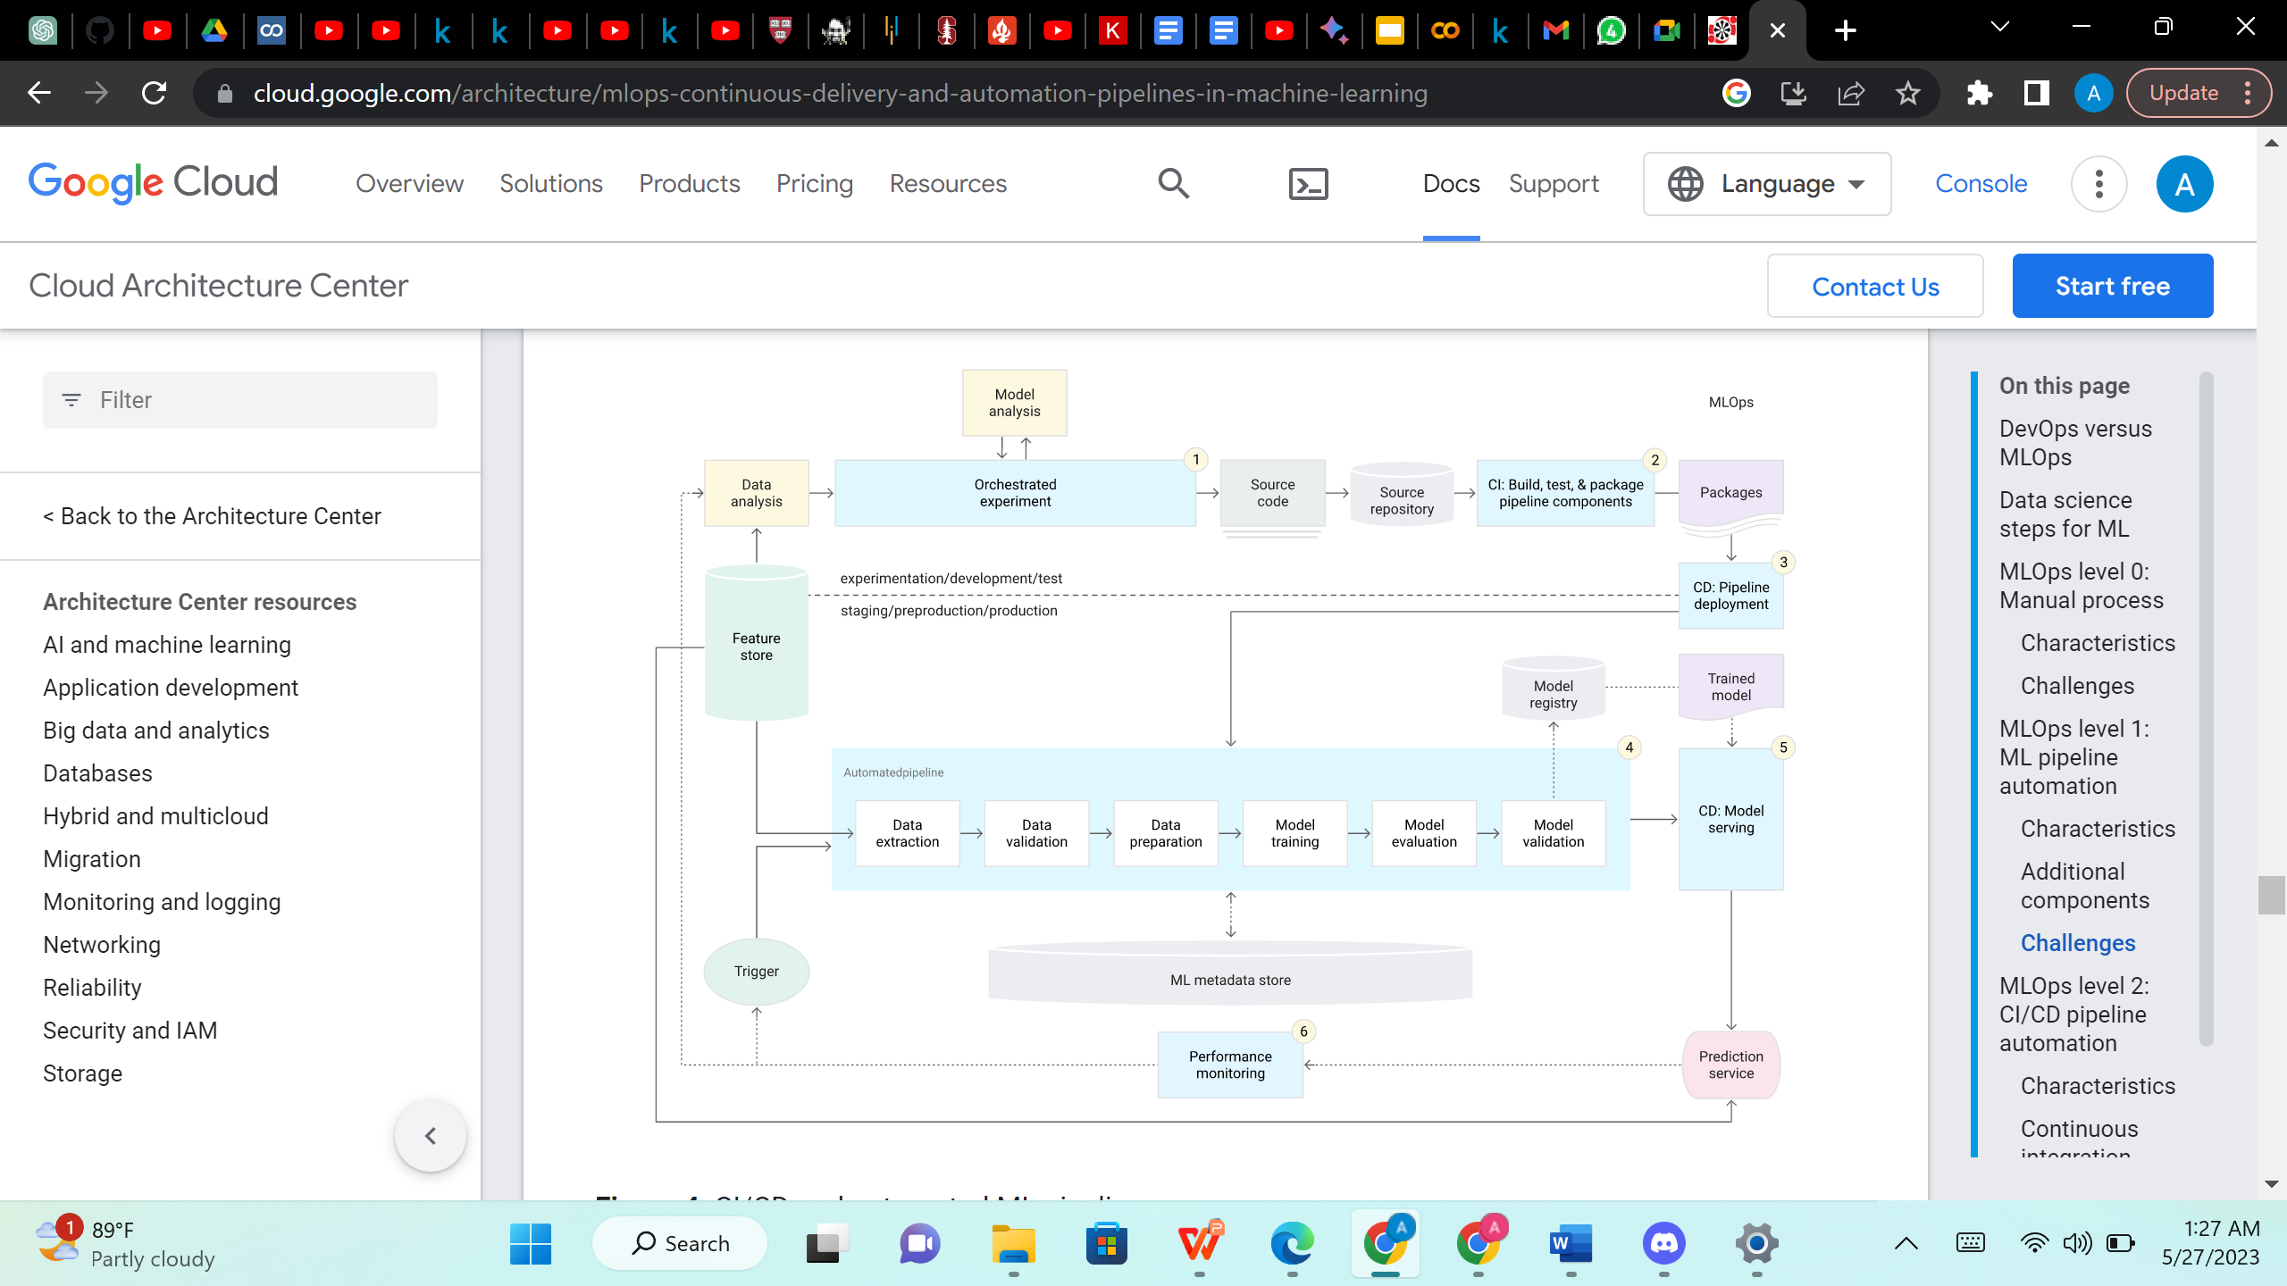
Architecture

Slide 12
Proposed Approach
In the pursuit of plant disease classification, we have explored different models, including convolutional neural networks (CNNs), with a particular focus on ResNet and VGG16.
CNNs are specialized deep learning algorithms for image classification, enabling them to recognize patterns and categorize images accordingly.
ResNet, a powerful CNN architecture, excels in capturing long-range dependencies within images, making it ideal for complex or diverse plant disease classification tasks.
VGG16, another effective CNN model, specializes in learning local features in images, making it well-suited for classifying detailed or simpler plant disease images.
By considering and experimenting with these CNN models, I aim to devise an optimal approach for accurate plant disease classification.

Slide 13
Proposed Approach
Let's delve into more details about the Convolutional Neural Network (CNN) architecture used in the implementation for plant leaf disease detection:
1. Input Layer:
- The input layer of the CNN is defined using `layers.Input`, specifying the shape of the input images (256x256 pixels with 3 channels for RGB).
2. Preprocessing Layers:
- Two preprocessing layers are applied using `layers.experimental.preprocessing.Resizing` and `layers.experimental.preprocessing.Rescaling`.
- `Resizing` is used to resize the input images to the specified size (256x256 pixels).
- `Rescaling` scales the pixel values to the range [0, 1] for normalization.
3. Convolutional Layers:
- The model consists of several convolutional layers with varying numbers of filters (32, 64).
- Each convolutional layer is followed by a rectified linear unit (ReLU) activation function, introducing non-linearity.

Slide 14
Proposed Approach
4. MaxPooling Layers:
- After each set of convolutional layers, max-pooling layers are applied (`MaxPooling2D`), reducing the spatial dimensions of the feature maps.
5. Flatten Layer:
- The last max-pooling layer is followed by a `Flatten` layer, which converts the 3D feature maps to a 1D vector.
6. Dense (Fully Connected) Layers:
- The flattened output is then fed into fully connected dense layers.
- A `Dense` layer with ReLU activation is used for feature extraction.
- The final `Dense` layer has 10 units (equal to the number of classes) and a softmax activation function, producing probabilities for each class.
7. Dropout Layer:
- Dropout layers are interspersed in the model, specifically after the first dense layer. Dropout is a regularization technique that helps prevent overfitting by randomly setting a fraction of input units to zero during training.

Slide 15
Proposed Approach
8. Model Compilation:
- The model is compiled using the Adam optimizer, which adapts the learning rates during training.
- The loss function is set to 'sparse_categorical_crossentropy' since the task is multi-class classification with integer labels. The evaluation metric is set to accuracy.
9. Training:
- The model is trained using the `fit` method on the training set.
- The training process is monitored, and training metrics (loss and accuracy) are recorded over epochs.
10. Model Saving:
- The trained model is saved in both an HDF5 file and as a versioned model.
This CNN architecture follows a pattern for image classification tasks incorporating convolutional layers for feature extraction, max-pooling layers for spatial reduction, and fully connected layers for classification. The use of dropout helps prevent overfitting, and the model is trained using the various optimizer with sparse categorical cross-entropy as the loss function.

Slide 16
04
Conclusion

Slide 17
CONCLUSION
In conclusion, the exploration of different models for plant disease classification has provided valuable insights. Convolutional neural networks (CNNs) such as ResNet and VGG16 have been shown to be effective at classifying plant diseases. ResNets excel in capturing long-range dependencies, while VGG16s focus on local features. By leveraging the strengths of these models, we can develop an effective approach that improves the accuracy of plant disease classification.
The findings from this investigation will contribute to the development of a robust and reliable system for automated plant disease diagnosis. This will enable more effective management of crop health.

Slide 18
Thank you

